Slide 1
SALES STRATEGY ANALYSIS – NEW PRODUCT LAUNCH
Rekha K Raj IITM, BDM

Slide 2
Table of Contents
Business Goals
Current Sales Strategy Overview
Key Findings & Insights
Business Metrics
Strategic Recommendations

Slide 3
Business Goals
Pens and Printers has been delivering high-quality office products to large organizations since 1984. As consumer purchasing behavior continues to evolve, sales strategy must also adapt to meet changing expectations and to stay ahead in a competitive marketplace.
Six weeks ago, a new line of office stationery was launched. In line with this, the sales team is testing three different sales strategies to determine the most effective approach for driving customer engagement and increasing sales.
The aim of this presentation is to provide insights to the sales team on:
How are the three sales strategies performing?
To determine the most effective approach to be implemented.

Slide 4



Current Sales Strategy
Email: The sales team uses targeted email campaigns to reach both existing clients and potential new customers. These emails include product highlights, promotional offers, and personalized messaging tailored to the recipient’s purchasing history.
Call: Customers in this group were contacted directly by a member of the sales team via phone. These calls focused on introducing the new line of office stationery, highlighting key features and benefits, and answering any immediate questions.
Email + Call: Customers in this group first received a product information email, providing an overview of the new office stationery line. One week later, a member of the sales team followed up with a phone call to discuss the customer’s needs and explore how the new products could support their work.

Slide 5
KEY FINDINGS

Slide 6
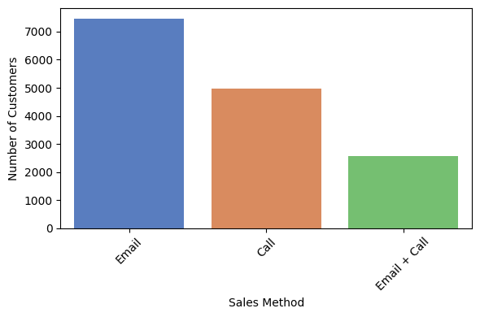
50% of customers were approached by email
No: of customers for each approach:
Email : 7466 → (50%)
Call : 4962 → (33%)
Email + Call : 2572 → (17%)

Slide 7
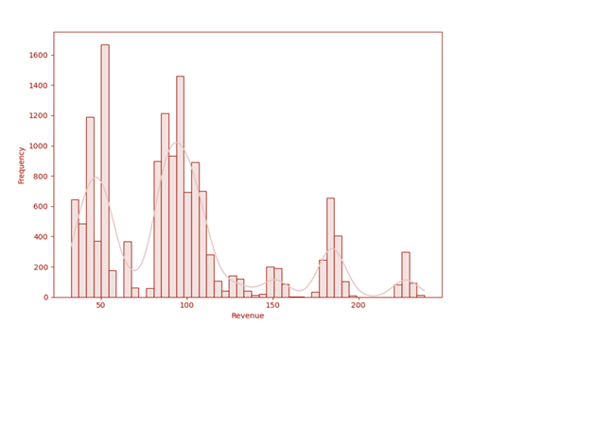
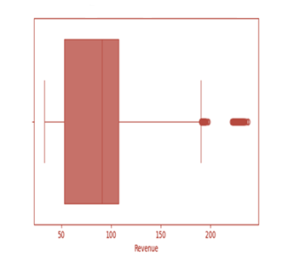
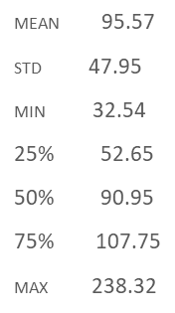
Overall revenue distribution is multimodal
The overall revenue distribution shows signs of being multimodal (with multiple peaks, each peak potentially corresponding to different sales approach)
The median revenue is USD 90.95, with the interquartile range (IQR) spanning from USD 52.65 to USD 107.75

Slide 8
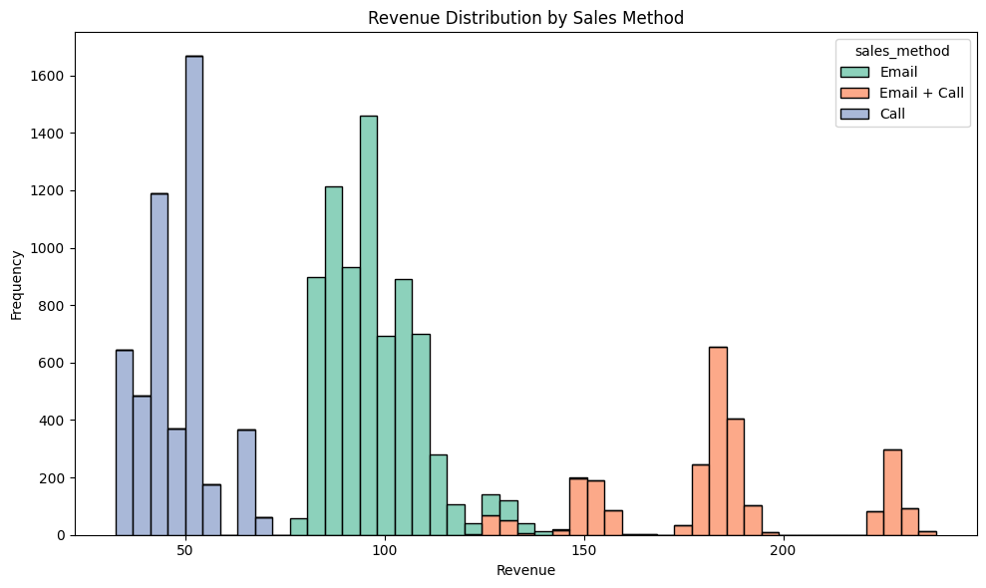
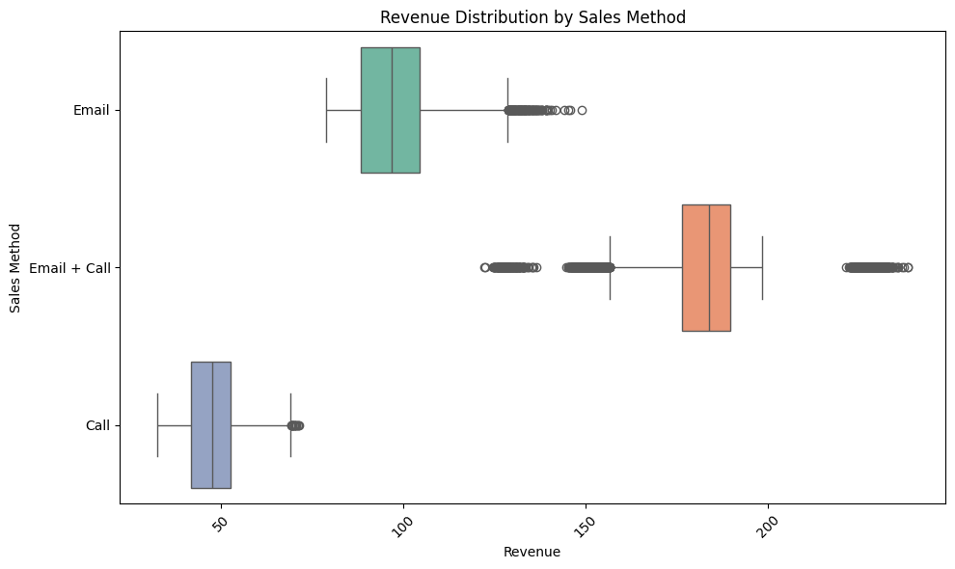
Email + Call has the highest median revenue
Revenue distribution for each approach:
Email has a right skewed distribution -- Most email campaigns yield low to moderate responses, with median value $96.3
Call has a slight right skewed distribution -- Most values are clustered around the lower to mid-range, median value = $ 47.60
Combination of Email and Call has a multi modal distribution with the highest median revenue of $183.74

Slide 9
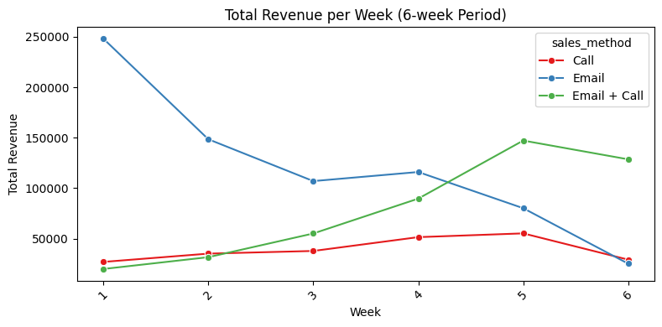
Combination of Email and Call approach has a positive revenue trend over the six week period
Total revenue over the six week period:
The email method, which initially generated the highest revenue, experienced a steady decline over time.
The call method demonstrated no revenue growth over the six weeks and underperformed in three of those weeks, generating the lowest revenue among all methods.
The combination of email and call methods showed a positive revenue trend with consistent growth over time.

Slide 10
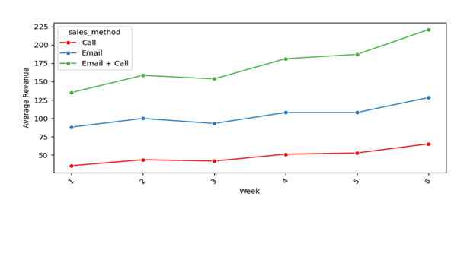
Combination of Email and Call method has the highest Average Order Value (AOV) in each week over six week period
Average revenue per order over the six week period:
The email and call combination achieved the highest average order value (AOV), reaching $220 by the end of week 6.
The AOV for the email method rose from $88 to $128 over six weeks, while the call method recorded the lowest AOV among the three approaches.

Slide 11
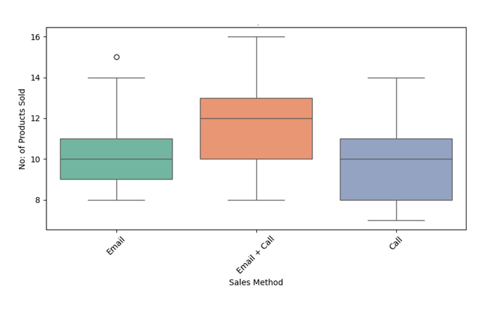
The median number of products sold is highest through Email and Call combination compared to other methods
Spread of the number of products sold for each sales method
The combined email and call approach yields the highest median number of products sold. Meanwhile, the median number of products sold using email alone is equal to that of the call-only method
Sales Method | count | min | 25% | 50% (median) | 75% | max
Call | 4962 | 7 | 8 | 10 | 11 | 14
Email | 7466 | 8 | 9 | 10 | 11 | 15
Email + Call | 2572 | 8 | 10 | 12 | 13 | 16

Slide 12
BUSINESS METRICS

Slide 13
BUSINESS METRICS
Monitoring the following metrics allows the sales team to gain insights into both financial performance (revenue-related) and customer behavior (order-related), enabling data-driven decision-making and strategy refinement.
Average Order Value(AOV) : The key metric that measures the average amount spent per order. Monitoring Average Order Value (AOV) is essential for understanding customer purchasing behavior, as it indicates whether customers are spending more per transaction on average.
Average Basket Size (ABS): ABS refers to the average number of items a customer purchases per transaction. It indicates customer buying habits and is useful for tracking performance of sales channels.
Total products sold: Total products sold measures the cumulative number of products sold over a specific period. This can help identify trends in sales volume as well as shifts in demand for particular products or categories.
Sales Method | AOV (USD/order) | ABS (unit/order) | Total Products Sold (unit)
Call | 47.60 | 9.51 | 47187
Email | 97.13 | 9.73 | 72639
Email + Call | 183.65 | 12.23 | 31444

Slide 14
RECOMMENDATIONS

Slide 15
RECOMMENDATIONS
Prioritize the Combination of email and phone calls as the primary customer engagement strategy by allocating additional sales team members and resources to support this hybrid approach. This method has demonstrated a clear positive trend, significantly boosting both total revenue and average order value (AOV).
The Email-only approach, with low operational cost is a valuable channel to maintain. The email approach should focus on innovation and continuous improvement such as personalization, automation etc to enhance engagement and conversion rates without increasing workload significantly.
The Call-only approach has consistently delivered lower performance in both total revenue and average order value (AOV), while also requiring considerably more time and effort from the sales team. As a result, this method should be discontinued as a standalone outreach strategy. Instead, resources should be reallocated to more effective approaches—such as the email and call hybrid method—which deliver stronger results with lower efforts.

Slide 16
THANK YOU

